Slide 1
Optical communications and data networks (EENGM2001)
Siddarth K Joshi

Slide 2
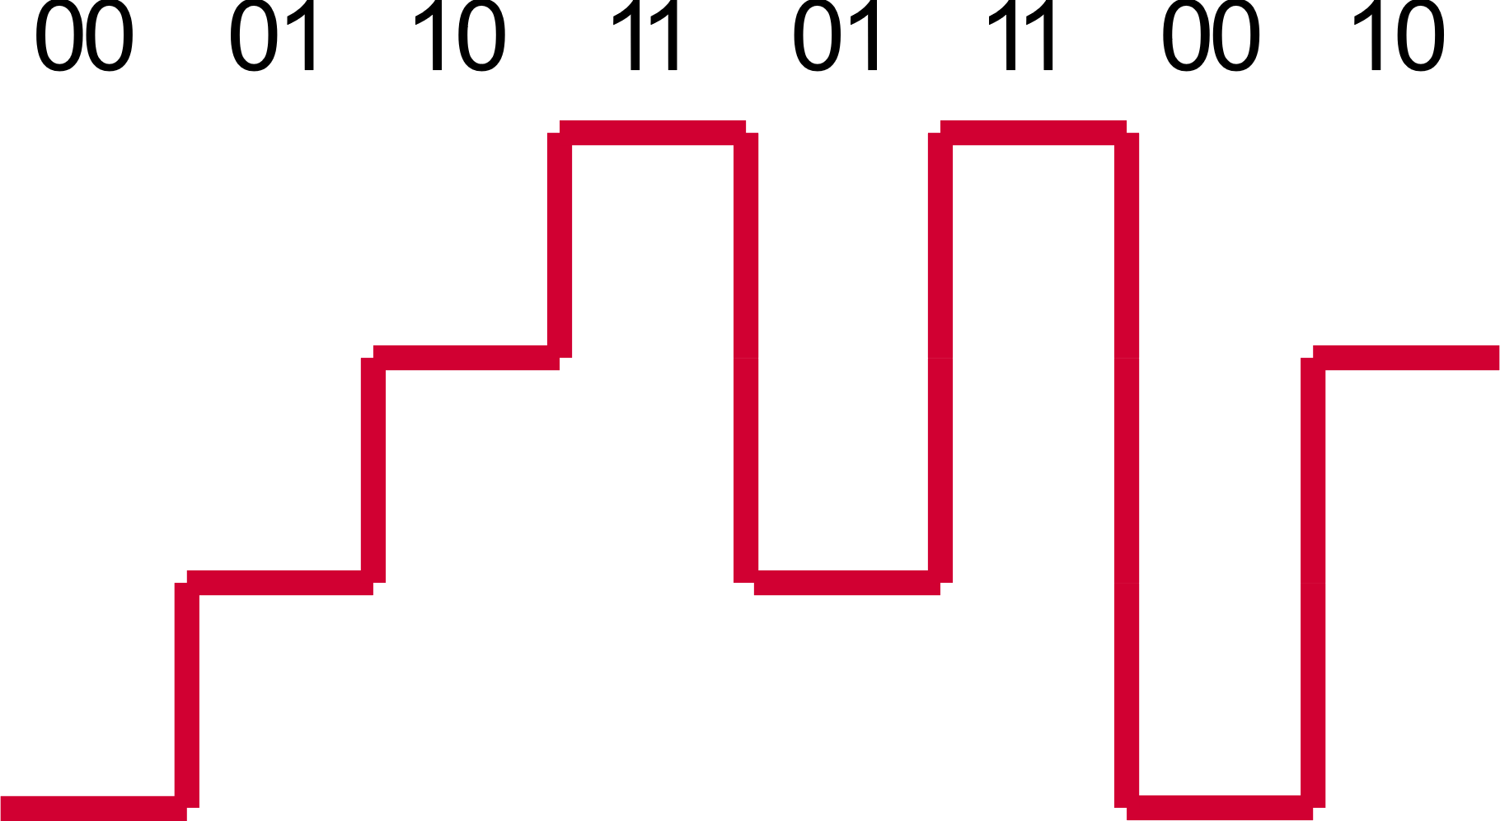
Recap:ASK
Each amplitude level represents one symbol
Better than OOK
Simple receiver
Baud rate = number of symbols (L) per second
Data rate = Baud rate * log₂(L)
We will calculate this error rate when we study demodulation and receivers
Increased error probability (lower SNR)

Slide 3
m-ASK
m-ASK has m symbols.
Pulse amplitude modulation is an analogue technique.
Do not confuse with digital ASK.
Analogue comms engineers will often call 2-ASK as PAM4 when referring to digital transmission that’s because they are so similar.

Slide 4
m-ASK
P_{max}
Inter symbol distance
P₀
Inter symbol distance = (P₀-P_{max})/m
Large inter symbol distance = better SNR

Slide 5
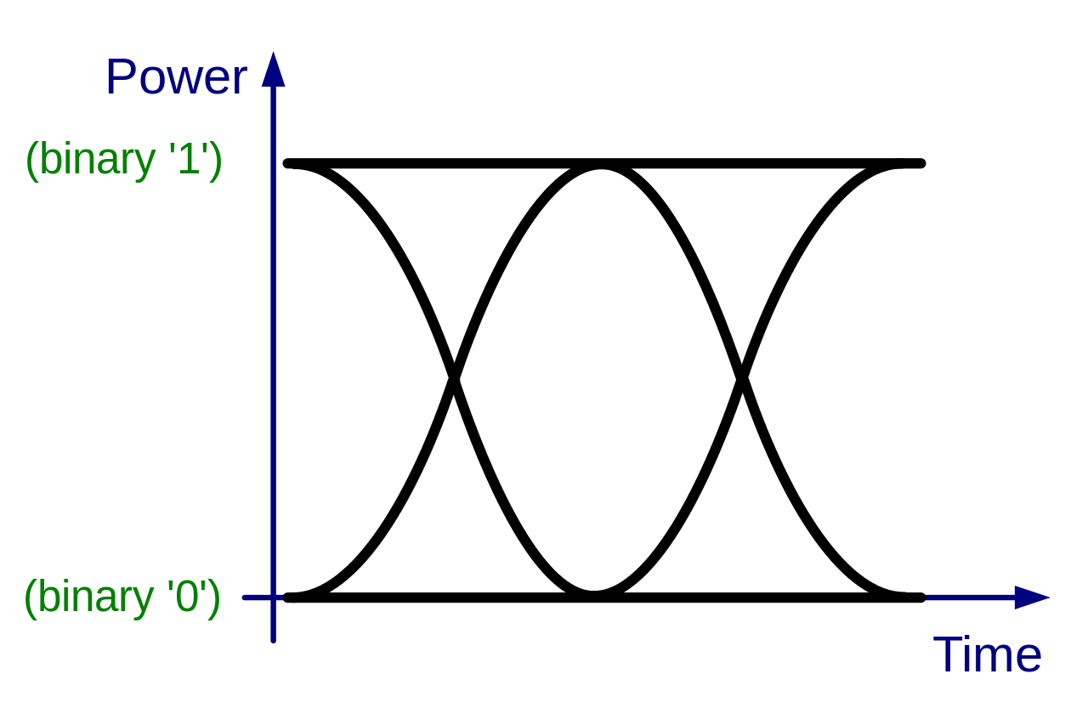
Eye diagrams
Perfect OOK eye diagram
Oscilloscope display in which a digital signal from a receiver is repetitively sampled and applied to the vertical input, while the data rate is used to trigger the horizontal sweep

Slide 6
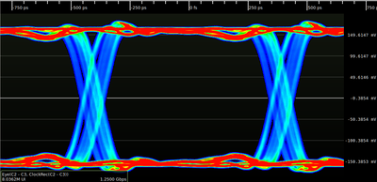
OOK eye diagram
Persistence view of an oscilloscope.
Colour represents the number of pulses/points
Averaged over millions of pulses

Slide 7
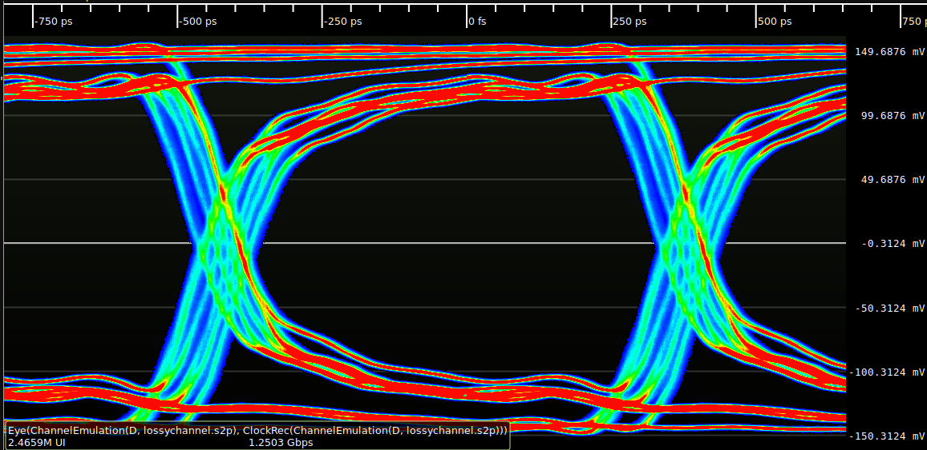
Eye diagrams
Used to detect flaws in the transmission.
What is the flaw here?
Notes:
High frequency loss.

Slide 8
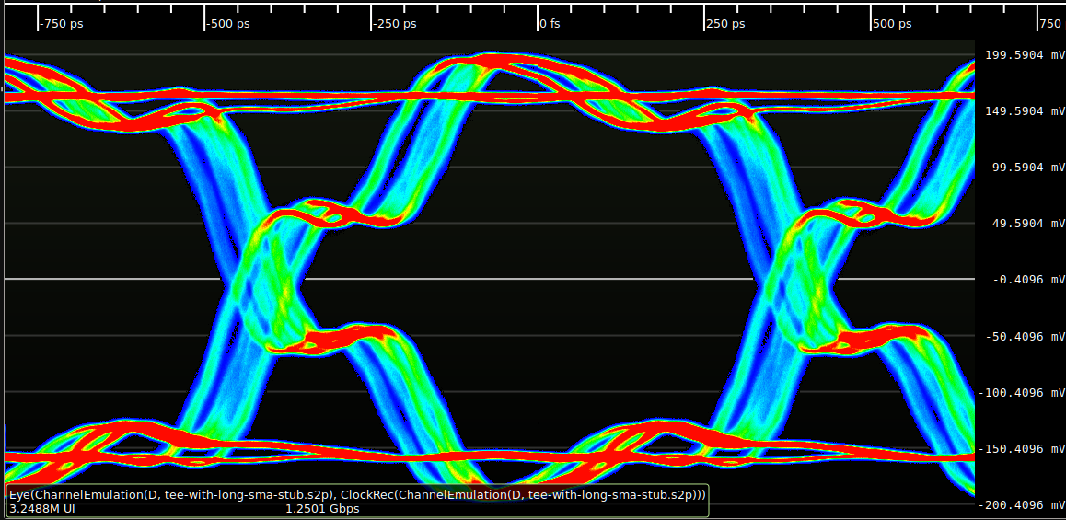
Eye diagrams
Impedance mismatch or back reflection from un-terminated fibre (stub)
Example of inter symbol interference
1.25 Gbps OOK, with a stub causing delay of 0.4 T
(T is duration of symbol pulse)
Notes:
High frequency loss.

Slide 9
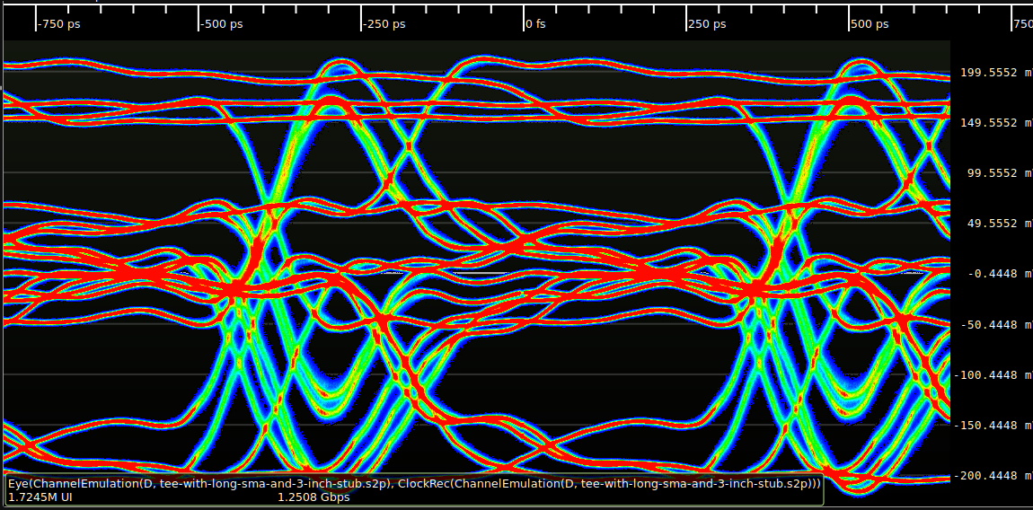
Eye diagrams
If inter symbol interference is too strong then the eye diagram is a mess and not useful.
Slowing the baud rate will improve the eye diagram and allow better diagnostics.
1.25 Gbps OOK, with a stub causing delay of 1.6 T
(T is duration of symbol pulse)
Notes:
High frequency loss.

Slide 10
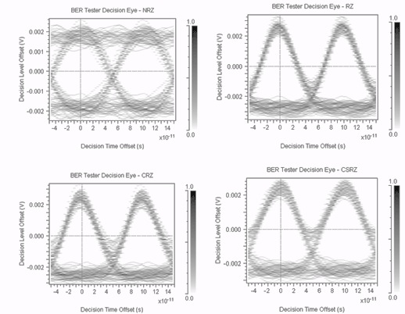
Eye diagrams
1-1 transition
0-1
transition
1-0
transition
0-1
transition
1-0
transition
0-0 transition
0-0 transition
T
NRZ modulation
RZ modulation
Notes:
High frequency loss.

Slide 11
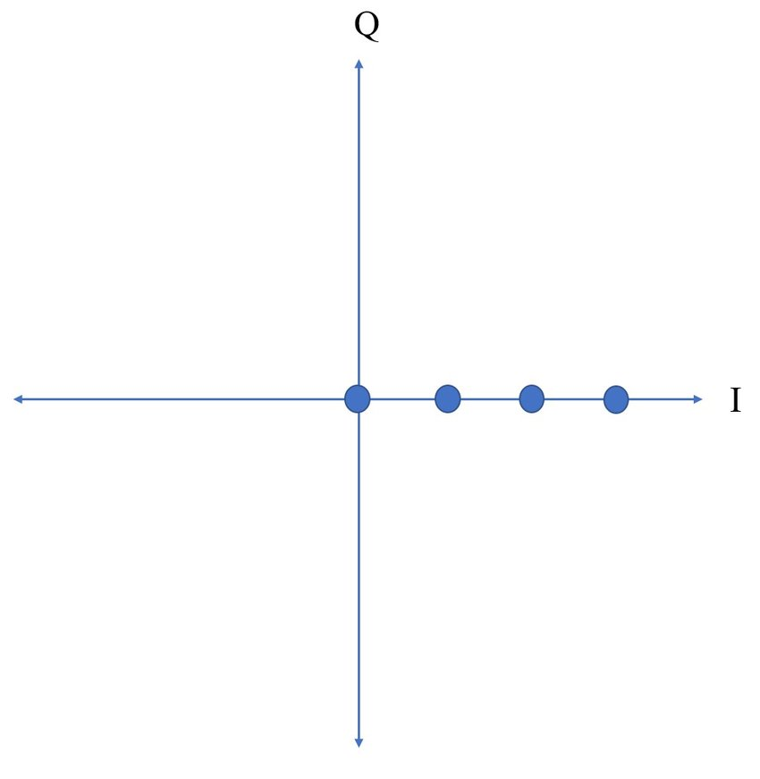
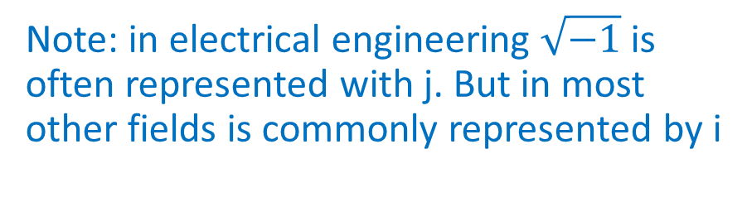
Constellation diagrams
Im(E)
Optical field E=E₀exp(jΦ)
Note: in electrical engineering $\sqrt{−1}$is often represented with j. But in most other fields is commonly represented by i
Phase
Re(E)
4 ASK constellation diagram
Optical ASK is always unipolar!
All symbols have the same phase

Slide 12
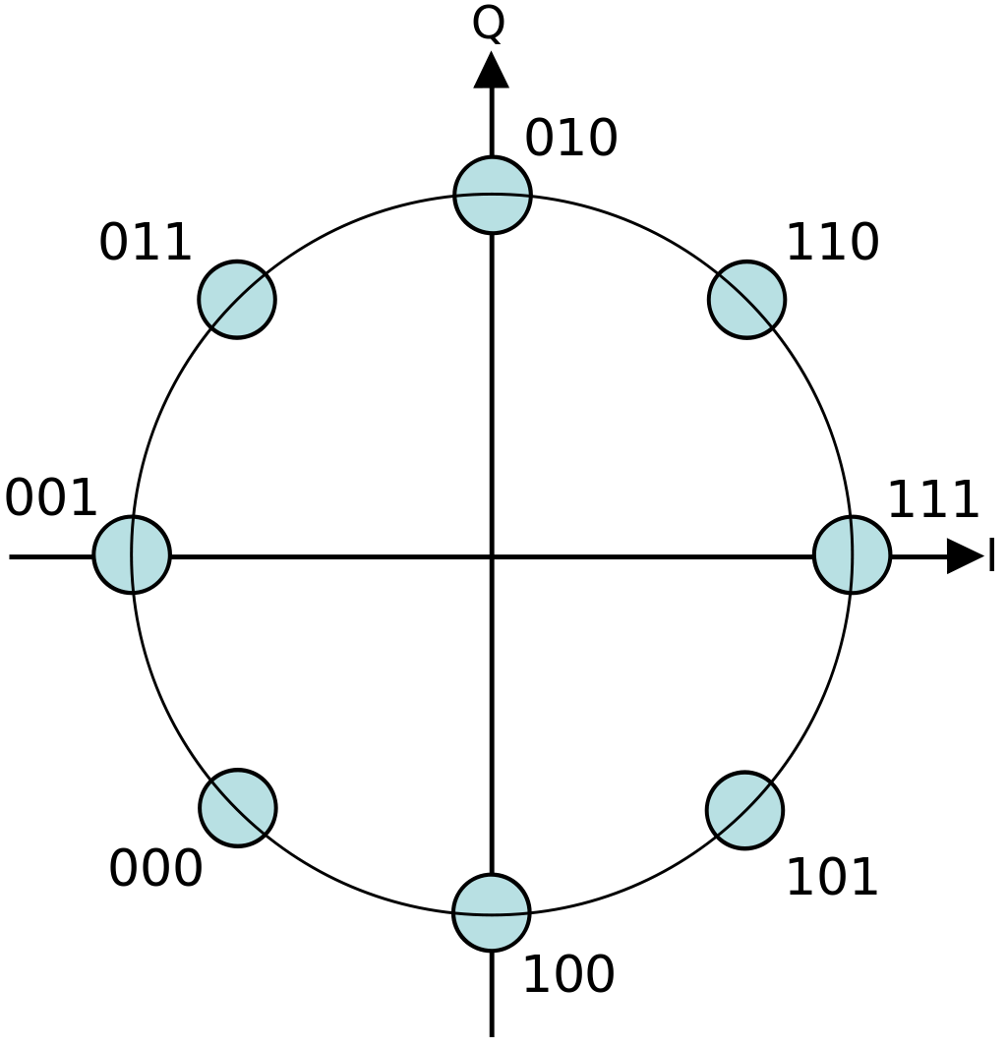
Constellation diagrams
All symbols have equal transmit power!
8PSK constellation diagram

Slide 13

Constellation diagrams
Optical field
E=E₀exp(jΦ)
$$E∝\sqrt{I}$$
E₀
Intensity modulation constellation diagram
Equally spaced in intensity = unequally spaced in amplitude

Slide 14
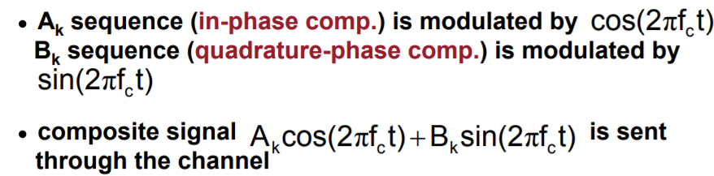
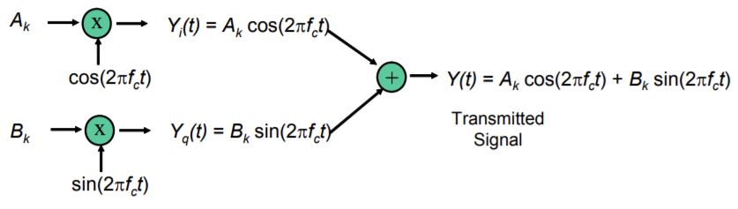
QAM
Split information into two data streams A_{k} and B_{k}
Sin and Cos are 90⁰ out of phase
Mix and transmit
For analogue f_{c} is carrier frequency for us πf_{c} is T – the symbol duration.

Slide 15
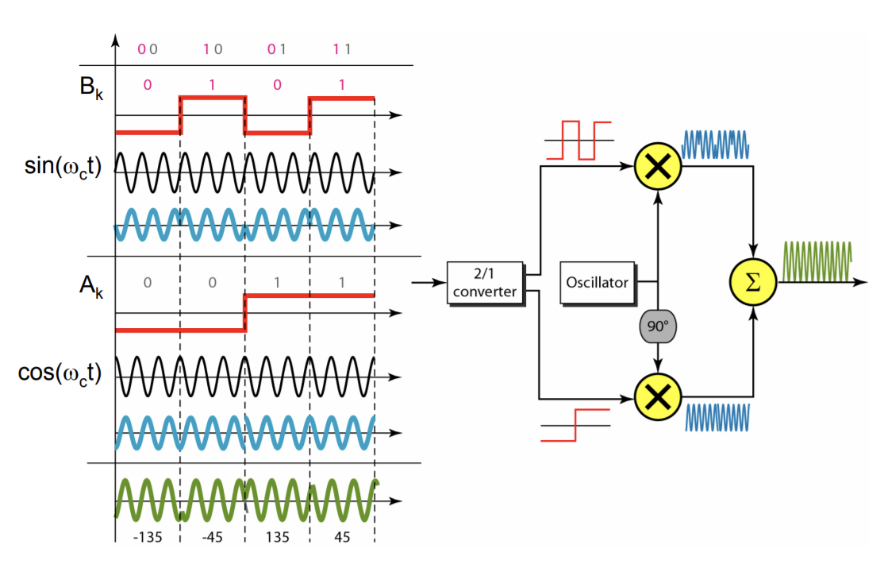
QAM
For optical communication the carrier is split into two phase components and each is amplitude modulated separately

Slide 16
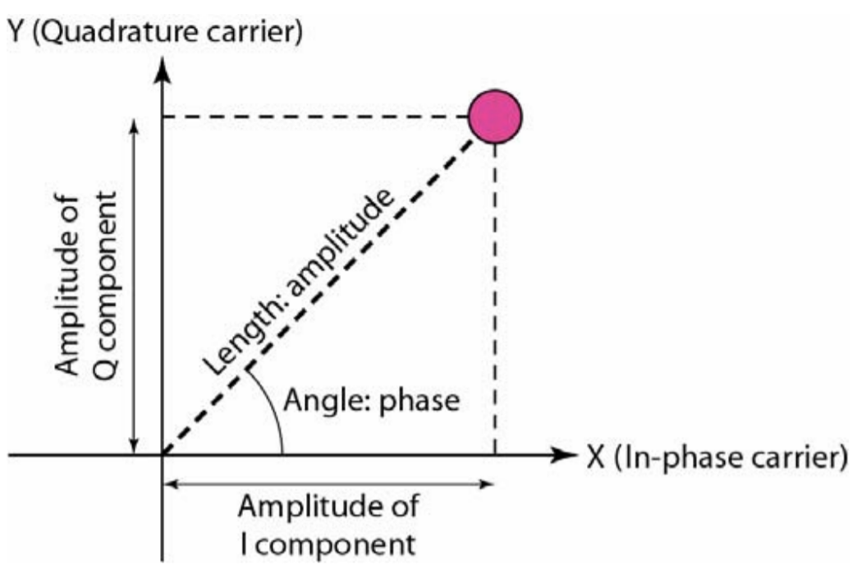
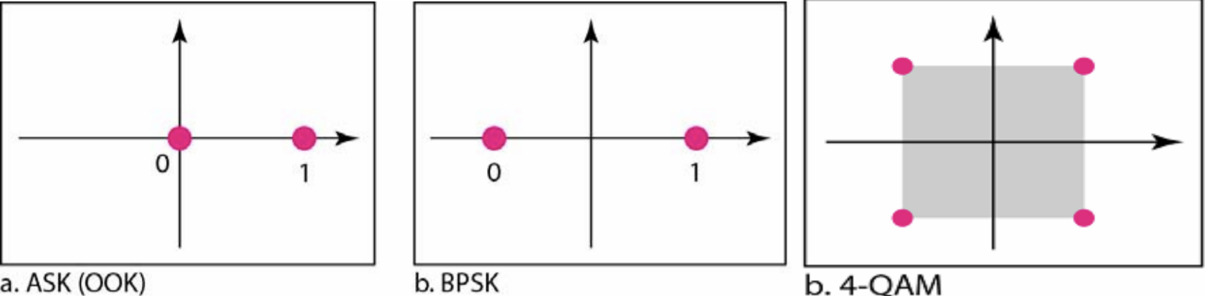
QAM

Slide 17
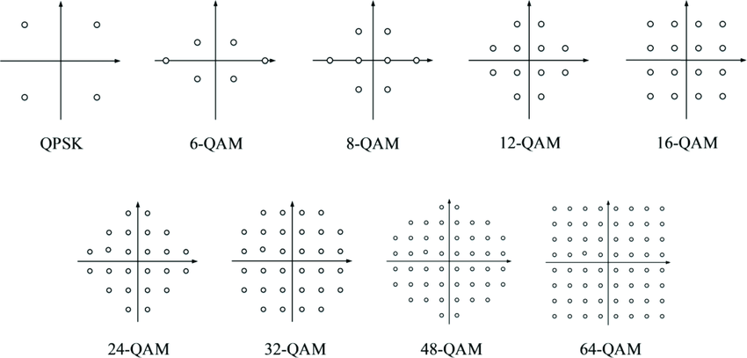
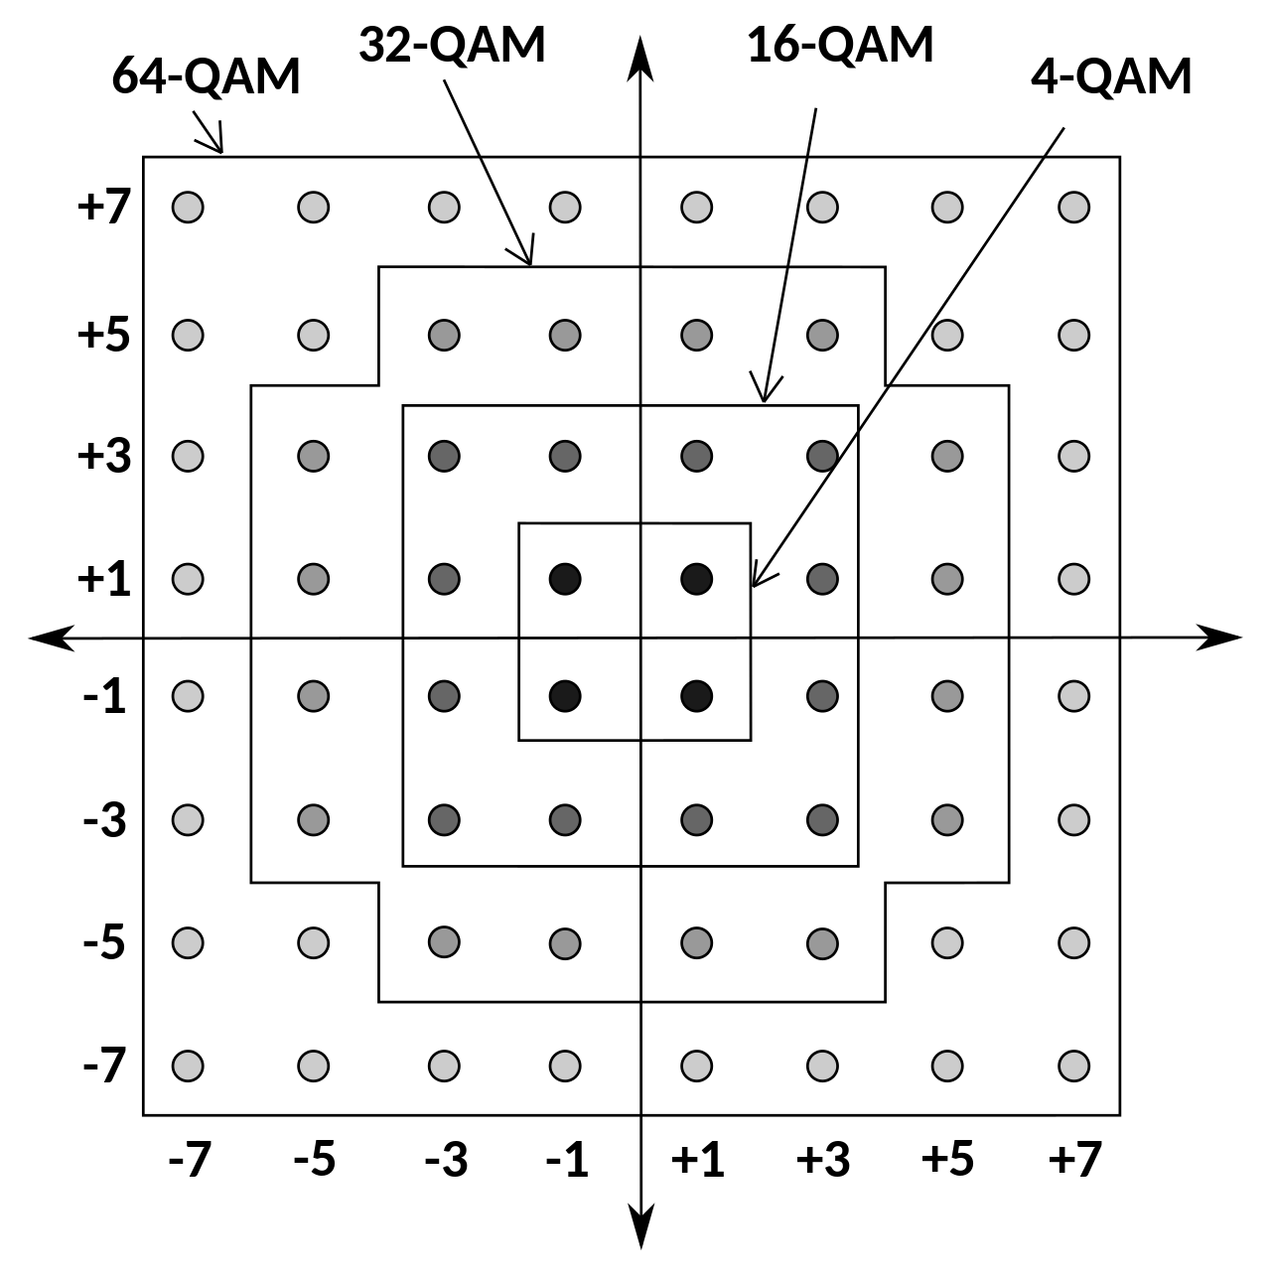
QAM
4QPSK has same constellation diagram as 4QAM

Slide 18
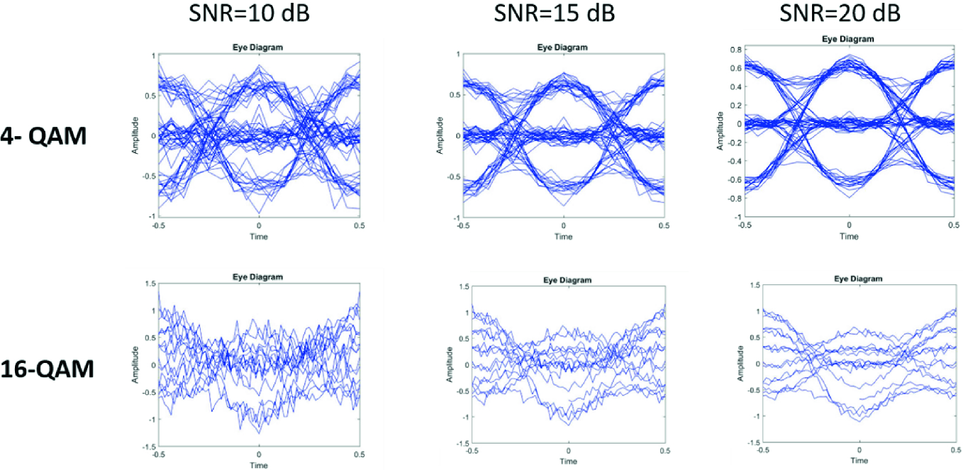
QAM
Ghayal, V.S. and Jeyachitra, R.K., 2020. Efficient Eye Diagram Analyzer for Optical Modulation Format recognition using Deep Learning Technique. In Advances in Electrical and Computer Technologies (pp. 655-666). Springer, Singapore.

Slide 19
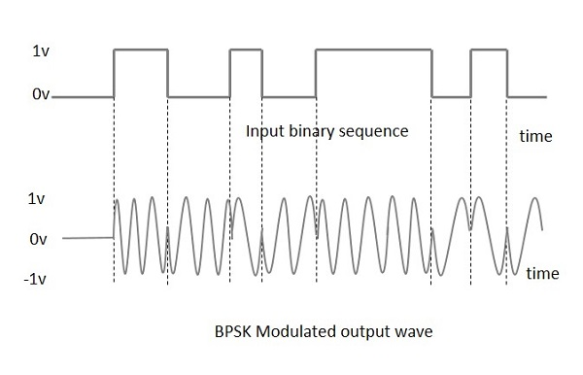
Recap:PSK
Amplitude is affected by noise and loss.
Phase of carrier wave less so.
Binary PSK L = 2 (0 0°, 1 180°)
Less sensitive to noise
Good for long distance and lossy links
Complex signal reconstruction Needs a local oscillator at carrier frequency.
Can you think of this before we discuss it in Week 15?

Slide 20
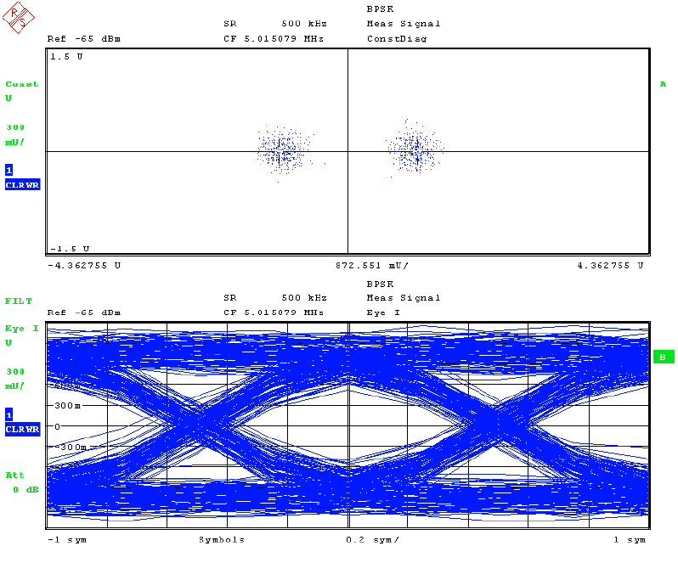
BPSK Eye diagram
Eye diagram is same as NRZ OOK. This is also a “2-state system”. Decoding the phase or the amplitude makes very little difference.

Slide 21
QPSK
Quadrature PSK uses 4 symbols with a 90⁰ phase difference.
Also called 4-PSK
Very similar to 4-QAM
No change in amplitude.

Slide 22
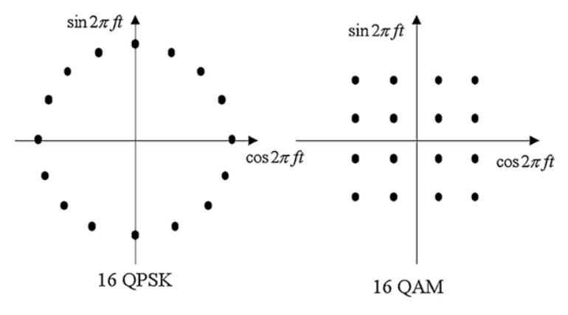
QPSK Vs QAM
BASIS FOR COMPARISON | QAM | QPSK
Stands for | Quadrature Amplitude Modulation | Quadrature Phase-Shift Keying
Spectral width | Narrow | Wide
Number of transmitted bits | Depends on its type | 2 bits
Performance | Average | Better
Bit error rate | High | Low

Slide 23
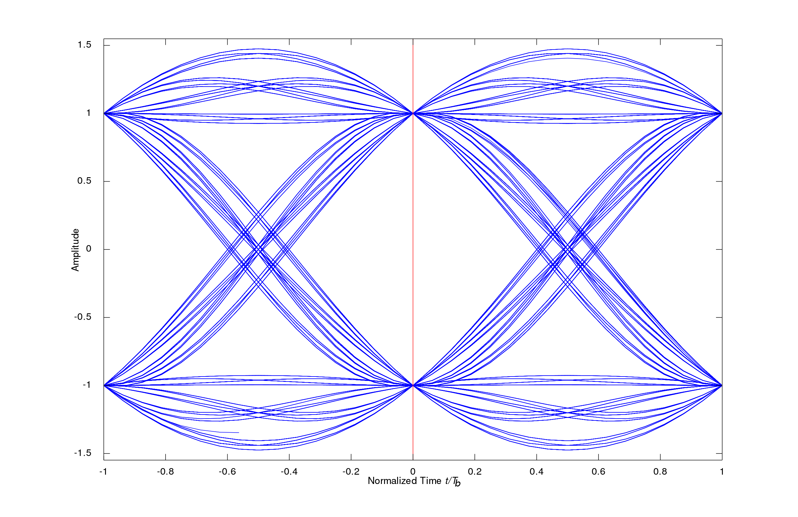
QPSK Eye diagrams
Not the same as 4-QAM,
In 4-QAM we have phase and amplitude change.
In QPSK there is just phase change.
Notes:
High frequency loss.

Slide 24

Recommended Reading
Agalliu, Rajdi, and Michal Lucki. "Benefits and limits of modulation formats for optical communications." Advances in Electrical and Electronic Engineering 12.2 (2014): 160-167.
https://core.ac.uk/download/pdf/84392529.pdf

Slide 25
Problem
Convert a frequency difference of 100 GHz at 1550nm to the corresponding wavelength difference. State your answer in nm.
Hint: Frequency difference is f₁ – f₂ and is not the same as 100 GHz directly expressed in nm.

Slide 26
Problem
A BAM scheme uses a signal amplitude of 0dBm for 1 and -10dBm for 0. With a duty cycle of 1. Calculate the average transmitted power.
With a time period of 1ns what is the frequency bandwidth of the modulator required?
If the duty cycle was 0.2 what would be the new average power and the new frequency bandwidth required for the modulator?
Explain the difference between the frequency bandwidth of the modulator and the optical bandwidth of the transmitted signal.

Slide 27
Problem
Draw Constellation diagrams for 8ASK, OOK

Slide 28
Problem
Why do we not use 16-PSK or 32-PSK etc? But still use 64-QAM?

Slide 29
Problem
Dual-polarization quadrature phase shift keying (DPQPSK) or dual-polarization QPSK uses two different polarisations each of which are modulated with a QPSK scheme. If the two polarisations are 0⁰ and 45⁰ and the receiver uses a polariser mounted at 22.5⁰ what fraction of each signal will the receiver see?
Is it possible to use a quad-polarisation QPSK scheme with a single monochromatic channel. Explain your answer.

Slide 30
Problem
What is the wave number of 1550nm light in vacuum and in a optical fibre of refractive index 1.5? Express the answer in cm⁻¹
Notes:
6451.61 cm^{–1}

Slide 31
Problem
A laser with a resistance of 1kohm and stray capacitance of 100pF is being directly modulated for an OOK scheme. Calculate the max baud rate at a 3dB cut off for the NRZ and RZ schemes. (Assume that the resistance and capacitance values provided form a simple first order low pass filter)
The duty cycle for the RZ scheme is 0.5.
What is the Baud rate for the same laser directly modulated with a 4ASK and 16ASK scheme.
Notes:
6451.61 cm^{–1}

Slide 32
Problem
If the transmitter needs a minimum OMA of 100μW and the maximum transmit power is 3dBm, what is the highest value of x in an x-ASK scheme that this transmitter can support?
Notes:
6451.61 cm^{–1}

